Slide 1
Enzyme experiment
Year 11 Biology
Bremer SHS

Slide 2
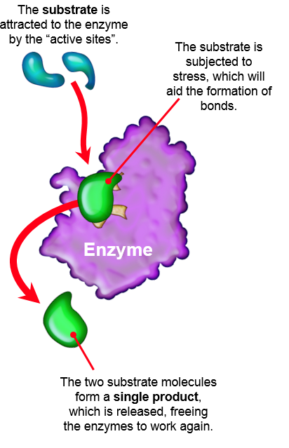
Enzymes
Enzymes are molecules that act as catalysts to speed up biological reactions.
Enzymes are not consumed during the biological reaction.
The compound on which an enzyme acts is the substrate.
Enzymes can break a single structure into smaller components or join two or more substrate molecules together.
Most enzymes are proteins.

Slide 3
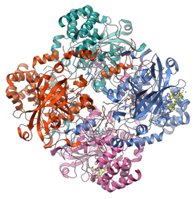
Background information
Catalase is an enzyme found in most aerobic cells, even in single-celled eukaryotes like yeast.
This experiment will extract catalase from a yeast solution and test its catalytic effectiveness on hydrogen peroxide (H₂O₂).
Catalase speeds up the breakdown of toxic peroxides (like H₂O₂) which may form during respiration (metabolic energy production).
The primary action of catalase is the decomposition of hydrogen peroxide (H₂O₂) to form water and oxygen.
2 H₂O₂ → 2 H₂O + O₂ (gas)
catalase

Slide 4
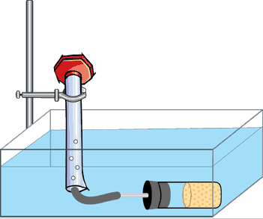
Experiment set up
stand
graduated measuring cylinder
clamp
water bath
reaction chamber, with stopper and tube

Slide 5
PART A
Make the water bath 30 degrees.
Measure and pour 10mL of hydrogen peroxide (H₂O₂) into the unstoppered reaction chamber.
Pipette 1mL of stock catalase solution (yeast solution) and IMMEDIATELY stopper the reaction chamber tightly, submerge it in the water bath and place the plastic tubing into the bottom of the measuring cylinder, so all the bubbles formed in the reaction chamber are captured in the inverted cylinder.
Measure the gas levels in the graduated cylinder at 30-second intervals for 5 minutes.
Record the gas levels (mL) in a data table.

Slide 6
PART b
5°C | Add ice to the water bath so that it is chilled to 5°C for 5 minutes before running the experiment. Keep adding ice (if necessary) to keep the temperature at 5°C or colder.
37°C | Add hot water to the water bath so that it is heated to at least 37°C for 5 minutes before running the experiment. Keep adding hot water (if necessary) to keep the temperature at 37°C.
100°C | Don’t use a water bath of boiling water as that is dangerous. Instead, use a solution of pre-boiled catalase. Run the experiment in room temperature water.
Repeat the experiment from Part A using 3 different temperatures: 5 ºC , 37 ºC, and 100ºC.

Slide 7
results
 | Time
Temp | 0 | 0.5 | 1 | 1.5 | 2 | 2.5 | 3 | 3.5 | 4 | 4.5 | 5
Room
5
37
100
Present your data as a compound line graph
Write a statement of results

